Slide 1


Mid-Semester Presentation
Clostrabio ELC Team

Slide 2
Agenda
Objectives
Market Opportunity
Direct Competitors
Indirect Competitors
Small Intestine Data
Next Steps
Conclusion

Slide 3

Objectives
Identify market opportunities.
Identify patient population and treatment costs.
Develop a product price.
Map the competitive landscape.
Identify key partners.

Slide 4

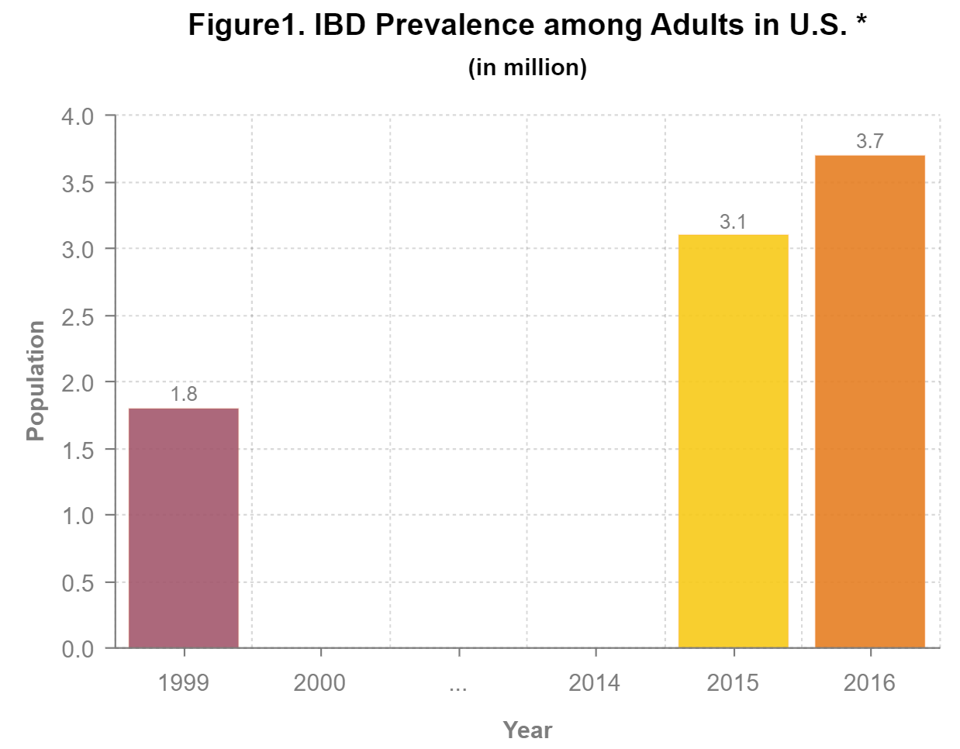
Market Opportunity - IBD Prevalence among Adults in U.S
For 2015 data,
Gender
Male: 1.31 million (43%)
Female: 1.77 million (57%)
Age groups
18-24: 153,000
25-44: 865,000
45-64: 805,000
Over 65: 1.26 million (40.6%)
Region
South: 1.18 million (58%)
Ethnicity
White: 2.34 million (75.5%)
National Health Interview Survey (2015)
National Health Interview Survey (2016)
Notes:
Will
update slide reference

Slide 5
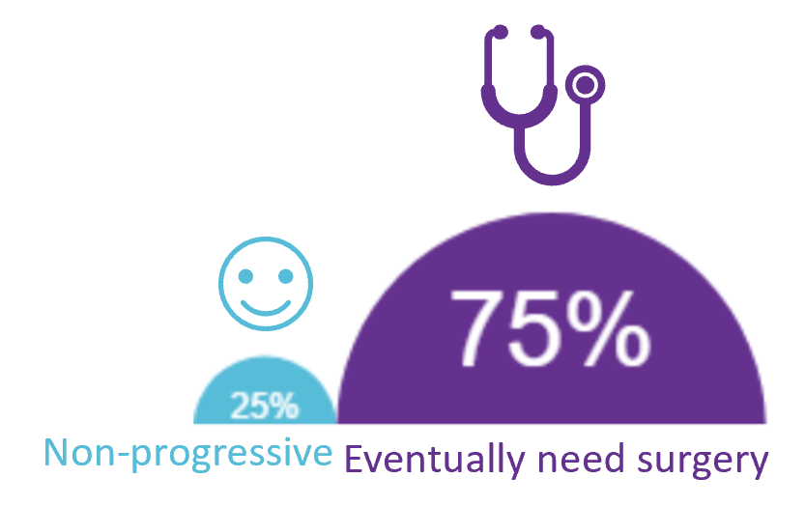
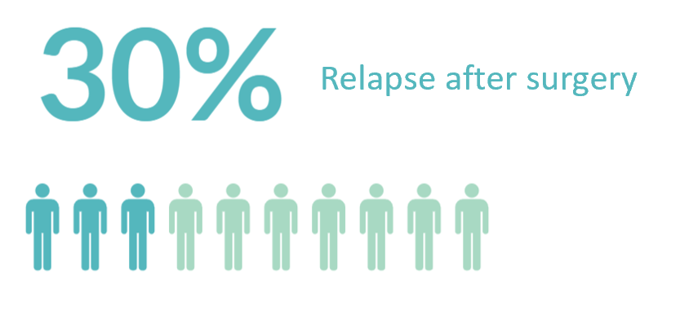
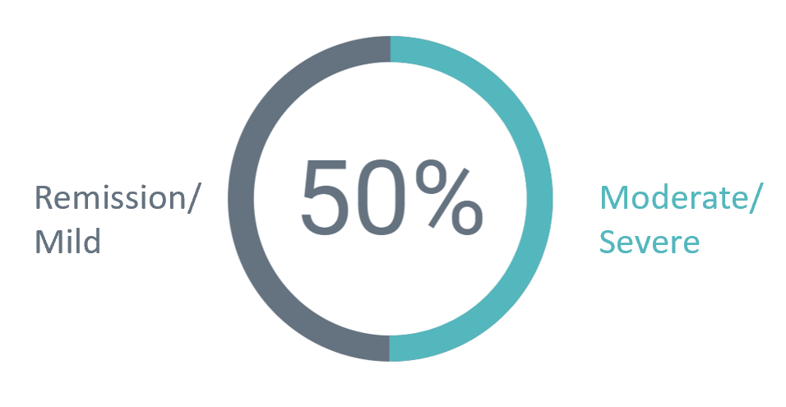
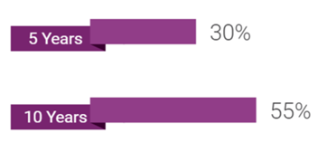
Market Opportunity - IBD Severity, Recurrence, and Progression
Crohn’s Disease
Sources:
https://www.crohnscolitisfoundation.org/assets/pdfs/surgery_brochure_final.pdf
http://www.crohnscolitisfoundation.org/assets/pdfs/ibdfactbook.pdf
Feuerstein, J. D., & Cheifetz, A. S. (2017, July). Crohn Disease: Epidemiology, Diagnosis, and Management. Mayo Clin Proc, 92(7), 1088-1103.
Mehta, F. (2016). Economic Implications of Inflammatory Bowel Disease and Its Management. American Journal of Managed Care, 22, S51–S62.

Slide 6
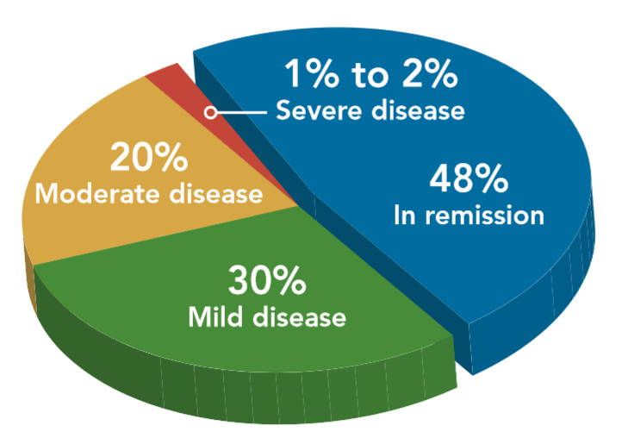
Market Opportunity - IBD Severity, Recurrence, and Progression
Ulcerative Colitis
30% (remission) relapse in the following year
No correlation between UC type and severity (Todd Linder)
Source: http://www.crohnscolitisfoundation.org/assets/pdfs/ibdfactbook.pdf

Slide 7
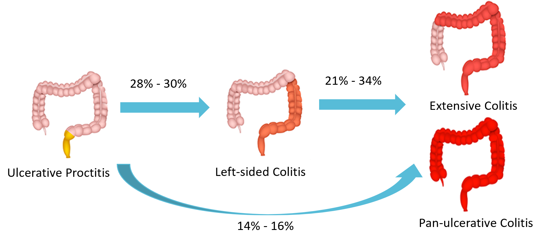
Market Opportunity - IBD Severity, Recurrence, and Progression
Ulcerative Colitis
Sources:
Fumery, M., Singh, S., Dulai, P.S., Gower-Rousseau, C., Peyrin-Biroulet, L., & Sandborn, W.J. (2017). Natural History of Adult Ulcerative Colitis in Population-based Cohorts: A Systematic Review16(3), 343-356.e3.
https://www.healthination.com/health/ulcerative-colitis-types

Slide 8
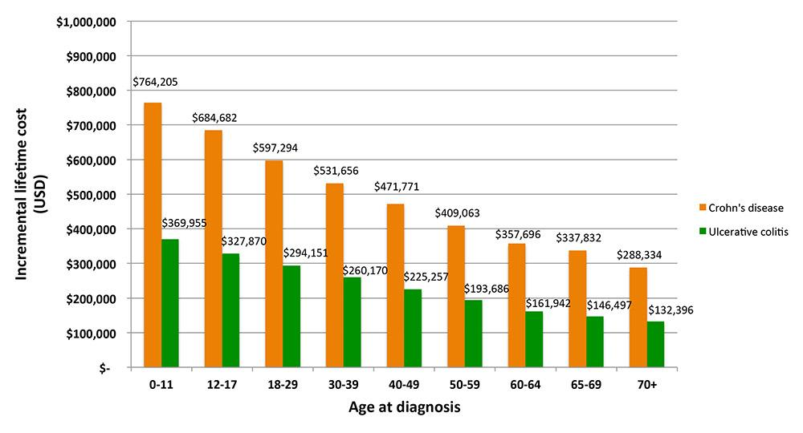
Market Opportunity - Overview of Economic Burden of IBD
Lifetime direct cost by age
Source: Lichtenstein, Gary R. The Economic Burden of Crohn’s Disease and Ulcerative Colitis in the United States: A Lifetime Healthcare Cost Analysis.

Slide 9
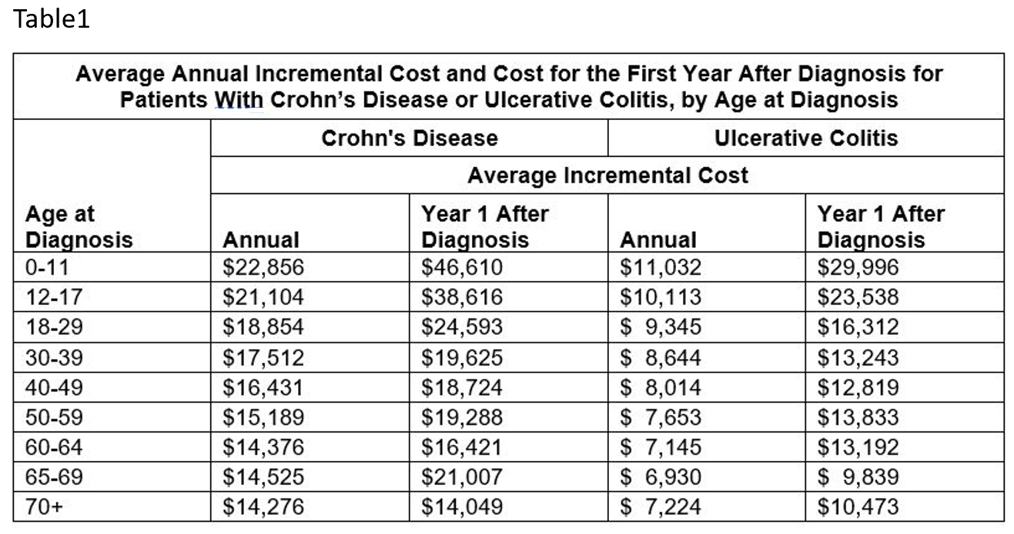
Market Opportunity - Overview of Economic Burden of IBD
Direct Costs
Average per year VS First year after diagnosis
*
Source: Baldassano, R. N., Shahabi, A., Seabury, S. A., Lakdawalla, D., Diaz, O., Baldassano, R. N., et al. (2018). P014 Average Annual Healthcare Costs for Pediatric and Adult Patients with Crohn’s Disease or Ulcerative Colitis. Inflammatory Bowel Diseases, 24(suppl_1), S1.

Slide 10
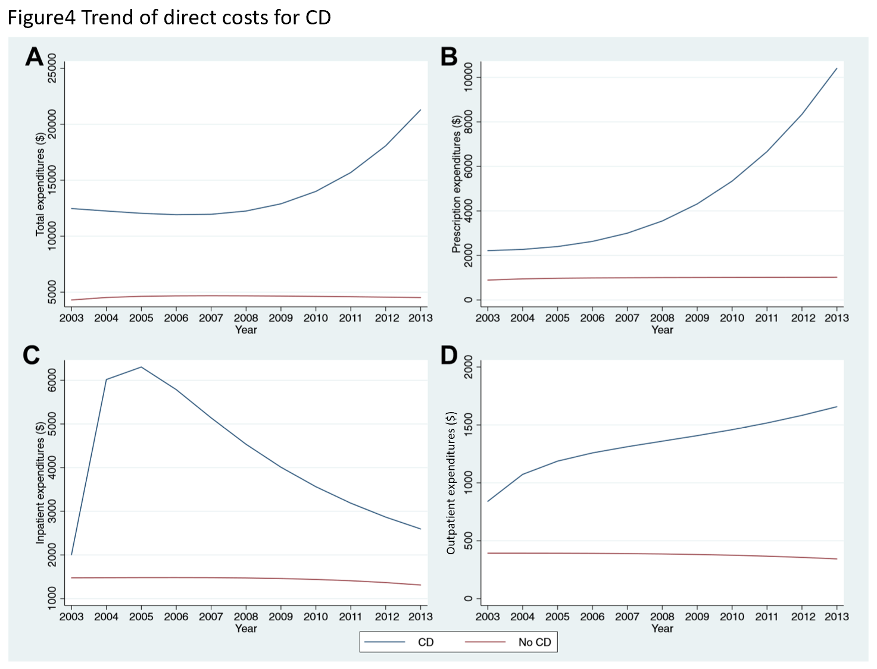
Market Opportunity - Overview of Economic Burden of IBD
Total direct cost

Slide 11
Market Opportunity - Overview of Economic Burden of IBD
Prescription cost

Slide 12
Market Opportunity - Overview of Economic Burden of IBD
Inpatient cost

Slide 13
Market Opportunity - Overview of Economic Burden of IBD
Outpatient cost
Source: Bounthavong, M., Li, M., & Watanabe, J. H. (2017). An Evaluation of Health Care Expenditures in Crohn’s Disease Using the United States Medical Expenditure Panel Survey from 2003 to 2013, 13(3), 530-538.

Slide 14
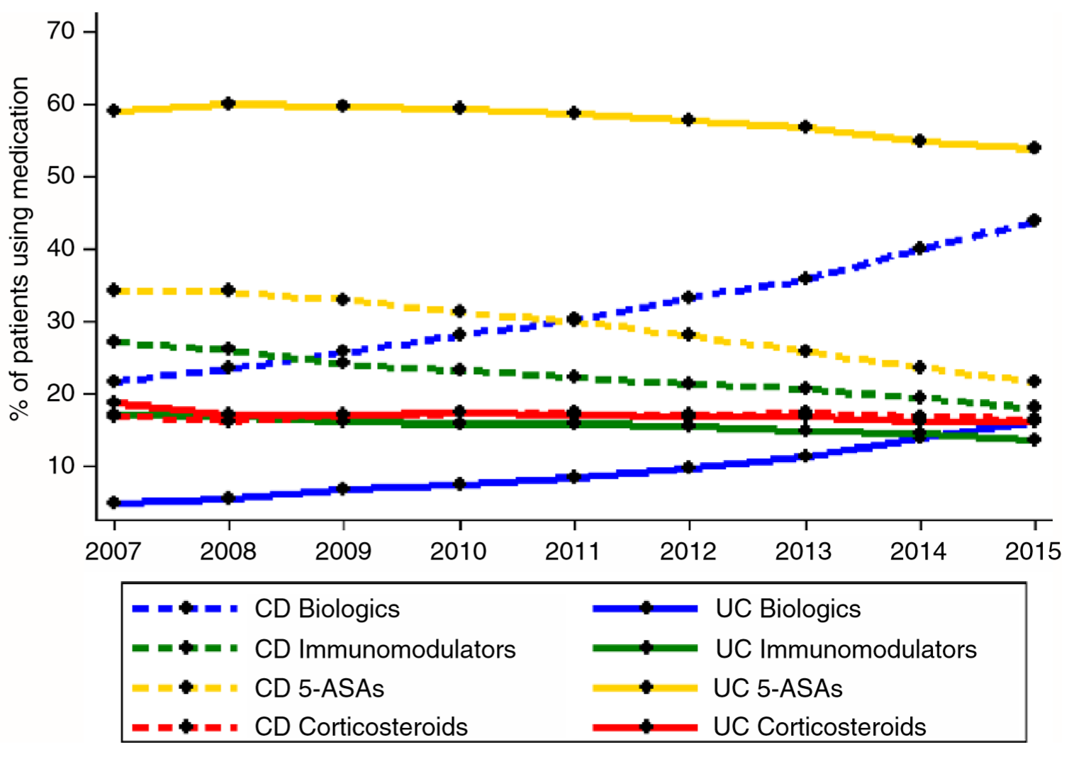
Market Opportunity - Market Share of IBD Drugs
Total IBD drug usage trend from 2007-2015
Biologics- ↑
Immunomodulator- ↓
5ASA- ↓
Corticosteroid - Stable
Yu, H., (2018). Market share and costs of biologic therapies for inflammatory bowel disease in the USA. Alimentary Pharmacology & Therapeutics, 47(3), 364–370
Notes:
Will
Add reference to chart

Slide 15
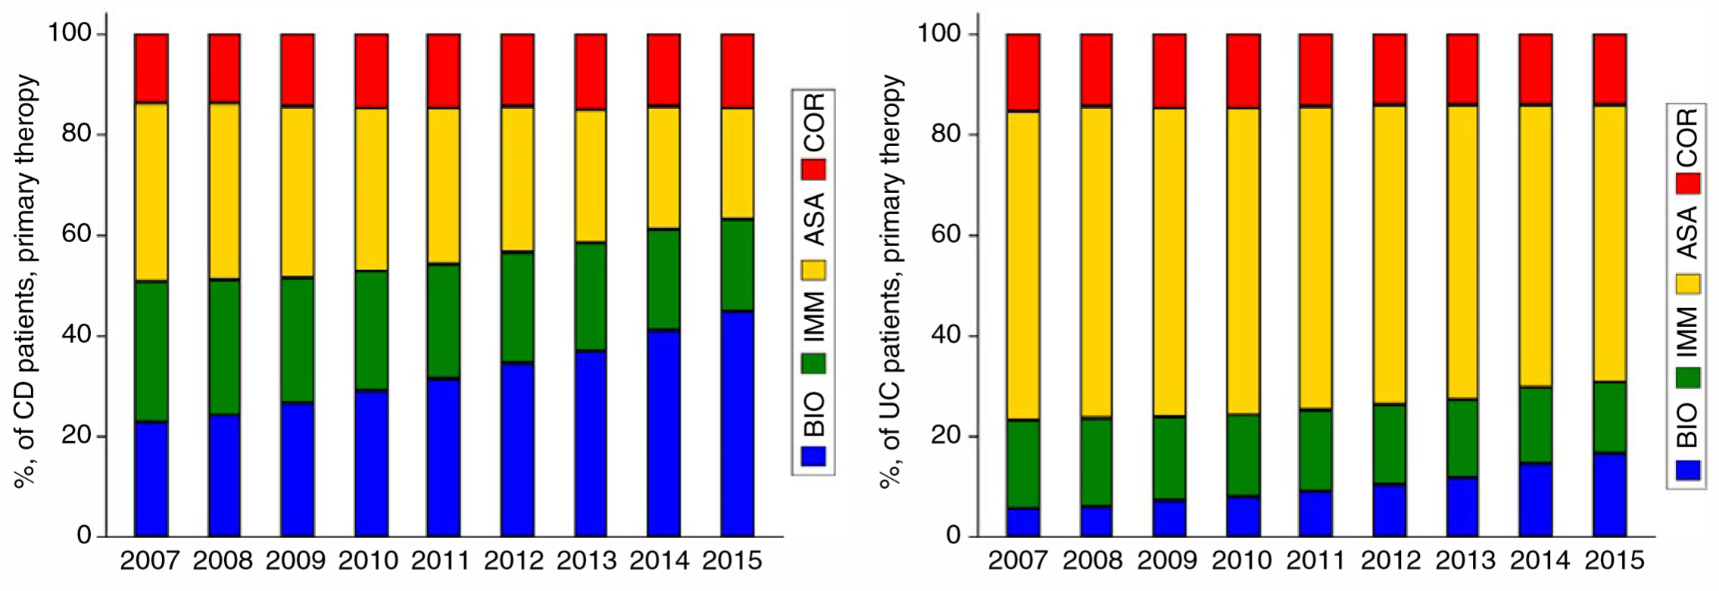
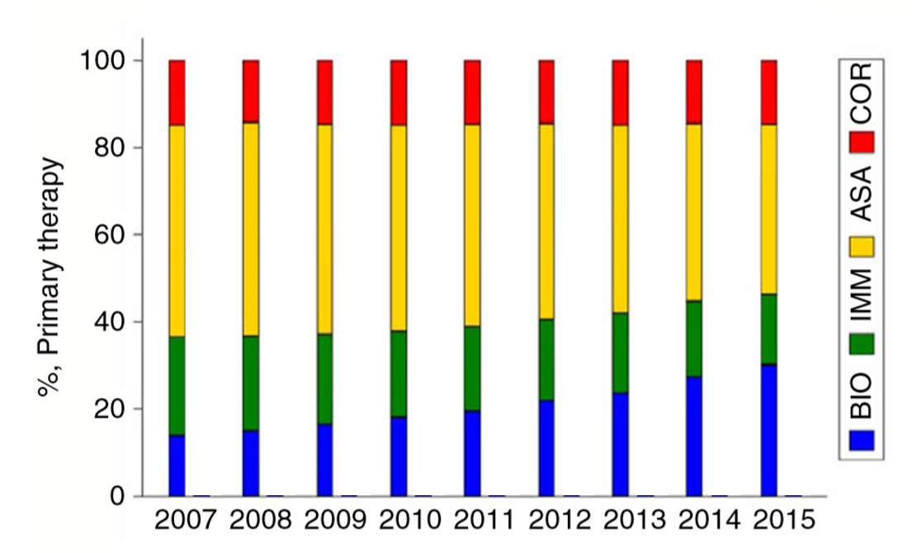
Market Opportunity - Market Share of IBD Drugs
IBD drugs as patients’ primary therapy trend for CD and UC
Increasing trend for biologics usage.
Biologics are chosen more by CD patients than by UC patients.
Biologics started to override ASA among CD patient.
Crohn’s Disease Ulcerative Colitis
Yu, H., (2018). Market share and costs of biologic therapies for inflammatory bowel disease in the USA. Alimentary Pharmacology & Therapeutics, 47(3), 364–370
Notes:
Will
Add reference to chart

Slide 16
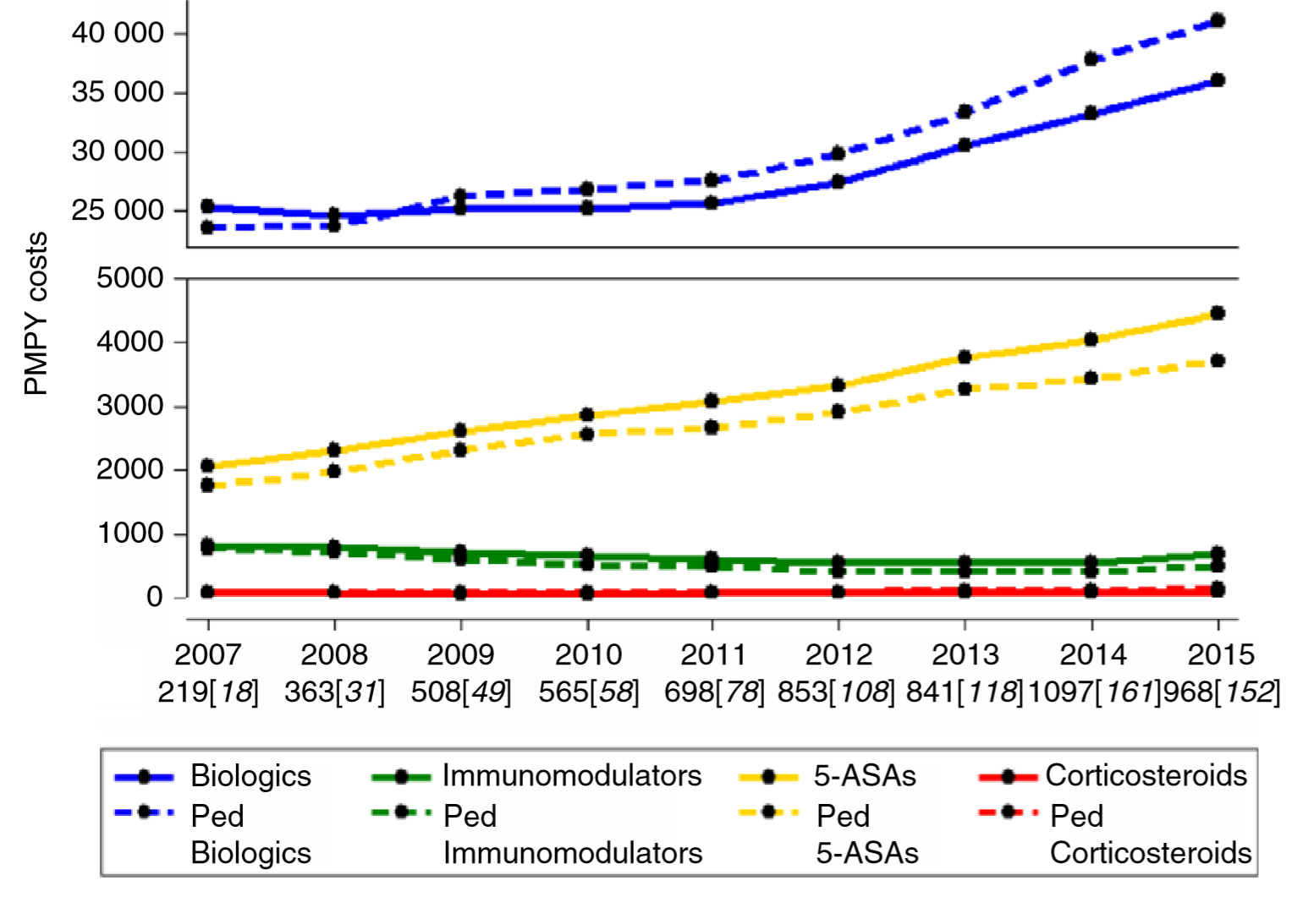
Market Opportunity - Market Share of IBD Drugs
IBD Medication Costs per patient, per year
Source: Yu, H., Sellers, Z. M., Wren, A. A., Bensen, R., Park, K. T., MacIsaac, D., … Wong, J. J. (2018). Market share and costs of biologic therapies for inflammatory bowel disease in the USA. Alimentary Pharmacology & Therapeutics, 47(3), 364–370.
Notes:
Will
Add reference to chart

Slide 17
Direct Competitors
Drug Types for mild-moderate IBD
Drug type | Targeted severity | Function
5-ASA | Mild to moderate | First step treatment to reduce inflammation; more effective in UC
Immunosuppressants | Mild to moderate | Reduce inflammation by suppressing the immune system response
Corticosteroids | Mild | Fight inflammation as a trigger of cortisol

Slide 18
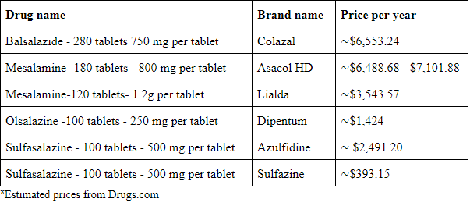
Direct Competitors - 5-ASA Drugs

Slide 19
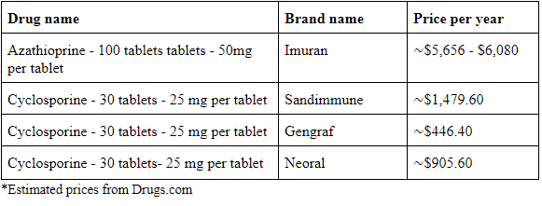
Direct Competitors- Immunomodulators (Immunosuppressants)

Slide 20
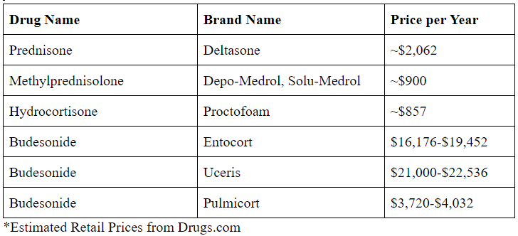
Direct Competitors- Corticosteroids

Slide 21
Indirect Competitors
Current Treatment for IBD.
Nutrition Deficiency.
Alternative Treatments for IBD.
Wound Healing of Intestinal epithelial cells.

Slide 22
Indirect Competitors
Current Treatment for IBD
Drugs that target IBD:
5-ASAs
Corticosteroids
Immunomodulators
Antibiotics
Biologic therapies

Slide 23
Indirect Competitors
Nutritional Deficiency
Nutrients that IBD patients need to supplement:
Iron
39%
Vitamin D
Pediatric patients
Linked to IBD risk
Zinc
Not as common

Slide 24
Indirect Competitors
Alternative Treatments for IBD
Side effects of current treatment
Consume alternative medicine
Natural therapy assistants
Antioxidants

Slide 25
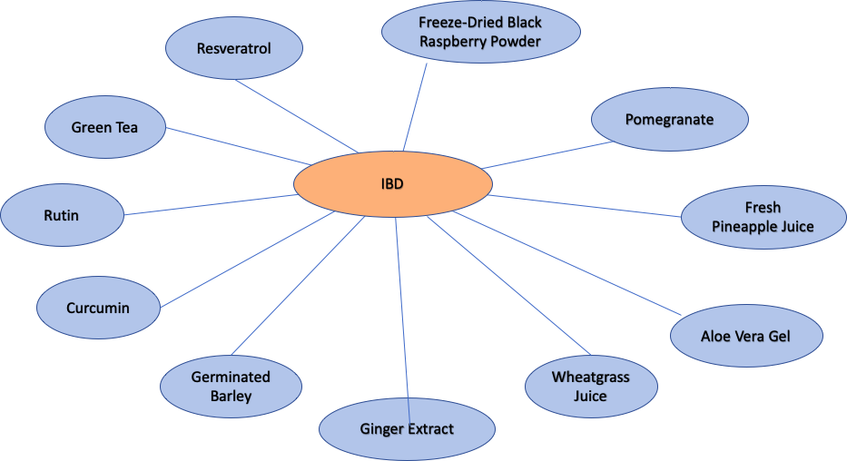
Indirect Competitors
Alternative Treatments for IBD

Slide 26
Indirect Competitors
Intestinal epithelial cells
Barrier Function of Intestinal Epithelial Cells (IEC)
Disruption and damage IEC
Vitamin D receptor experiment
Gastroprotective agents

Slide 27
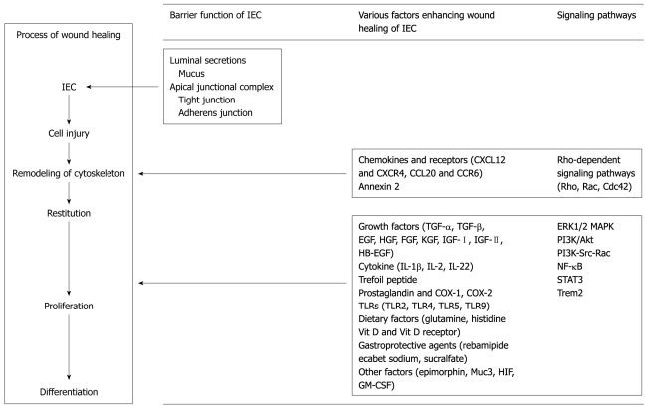
Indirect Competitors
Wound Healing Process

Slide 28
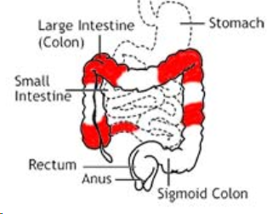
Small Intestine Data
Types of CD
Ileocolitis
Ileum and first part of colon
Up to 40-50% of population
Ileitis
In Ileum
Up to 30% cases of Crohn’s disease

Slide 29
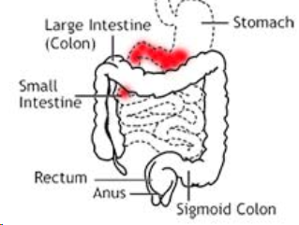
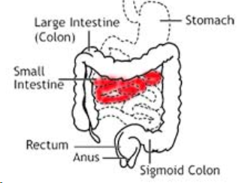
Small Intestine Data
Types of CD
Gastroduodenal
Stomach and duodenum (first part of small intestine)
Up to 5 % people affected
Jejunoileitis - jejunum
(middle and end of small intestine)
4% in adults & 20% children

Slide 30
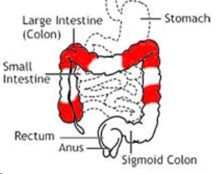
Small Intestine Data
Types of CD
Crohn’s colitis - colon only
Up to 20% of CD patients’ colon is affected
30 - 45% develop granulomas

Slide 31
Small Intestine Data
Medications
Drug type | Drug Name | Cost
5-ASA | Sulfasalazine (in the doses of 3–6 g daily) | 500 mg is $0.13 - 0.81 per pill or unit
Corticosteroid | CIR budesonide (a dose of 9 mg once daily) | 3 mg is $0.43 - 1.62 per pill or unit.

Slide 32
Small Intestine Data
Quick Facts
Oral 5-aminosalicylic acid is not recommended for long-term treatment
CIR budesonide should not be used beyond 4 months to maintain remission
Budesonide (Brands names- Entocort EC, UCERIS, Budenofalk) - steroids targeting the end of small intestine

Slide 33
Small Intestine Surgery
90% require surgery
Surgery types
Short-bowel syndrome
Strictureplasty is preferred

Slide 34
Small Intestine Surgery
Types of Strictureplasty
Short segments (<10 cm) Heineke-Mikulicz
Longer segments, Finney or Jaboulay

Slide 35
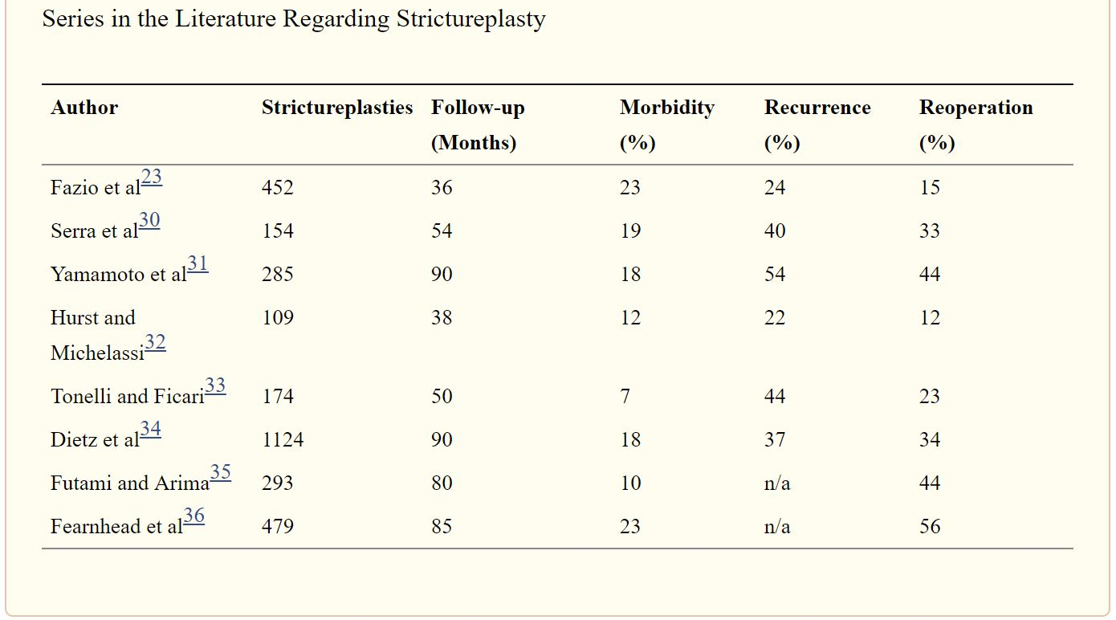
Small Intestine Surgery
Studies
Jobanputra, S., & Weiss, E. G. (2007, November)

Slide 36
Small Intestine Surgery
Resection
Ileocolic resection is common
72% recurrence rate
Potential for short-bowel syndrome

Slide 37
Next Steps
Final Presentation: April 26th.
Remaining Objectives:
Gather more Direct and Indirect costs data.
Determine ballpark ClostraBio product price.
Identify potential key partners.
Identify more Small Intestinal data.

Slide 38
Conclusion
Market Opportunity and Product Scope
Competition
Next Steps

Slide 39
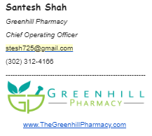
References
Medicine prescription information is provided by our connection Santesh Shah, pharmacist and Chief Operating Officer of Greenhill Pharmacy chain based in Wilmington, Delaware.

Slide 40
Q&A Session
Break for Questions, Answers, and Concerns
Thank you!

Slide 41



